Slide 1
GROUP 4, PROJECT 1
Team Members
Luis Bejaran
Mike Dunlap
Maria Sierra Lizarazo
Rainer Perry
Erin Urban

Slide 2
Agenda
Overview - Maria
Analysis review
Erin
Rainer
Maria
Mike
Luis
Post-Mortem
Q&A
Note: Each speaker will draw conclusions on their analysis

Slide 3
Motivation and Summary
Hypotheses
Population mobility varies in the US according to the state and the distance
Travel in the US declined during Covid.
Questions
Comparison of daily travel distances by state
Correlation between distance and number of trips
Travel data during COVID-19 analysis
Comparison of people staying at home vs. people travel in the state of NY
Comparison between weekdays and weekends

Slide 4
Data Exploration and Cleanup
Data source
US Department of Transportation, Bureau of Transportation Statistics
https://data.bts.gov/
Dataframe shape: (32028, 17)
Date range: Jan 1, 2019- Sept 19, 2020
Cleaning
Converted format to float for all numeric columns
Converted ‘date’ column to usable data by “apply(pd.to_datetime)”
“2020-09-19T00:00:00.000” to “2020-09-19”
Important concepts
Trip: movement that include staying longer than 10 minutes away from home.
Multiple stays away from home are considered multiple trips
Transportation methods: driving, rail, transit, and air
Experimental dataset

Slide 5
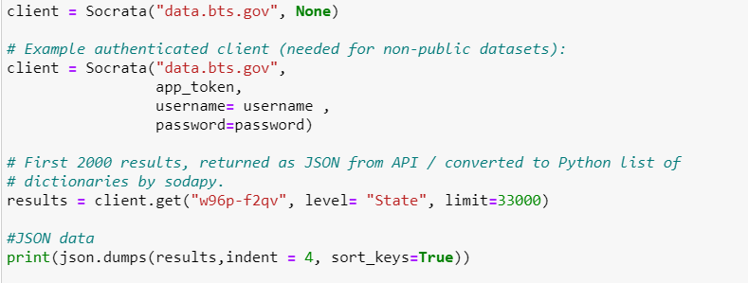
Data Exploration and Cleanup
API request for getting the information

Slide 6
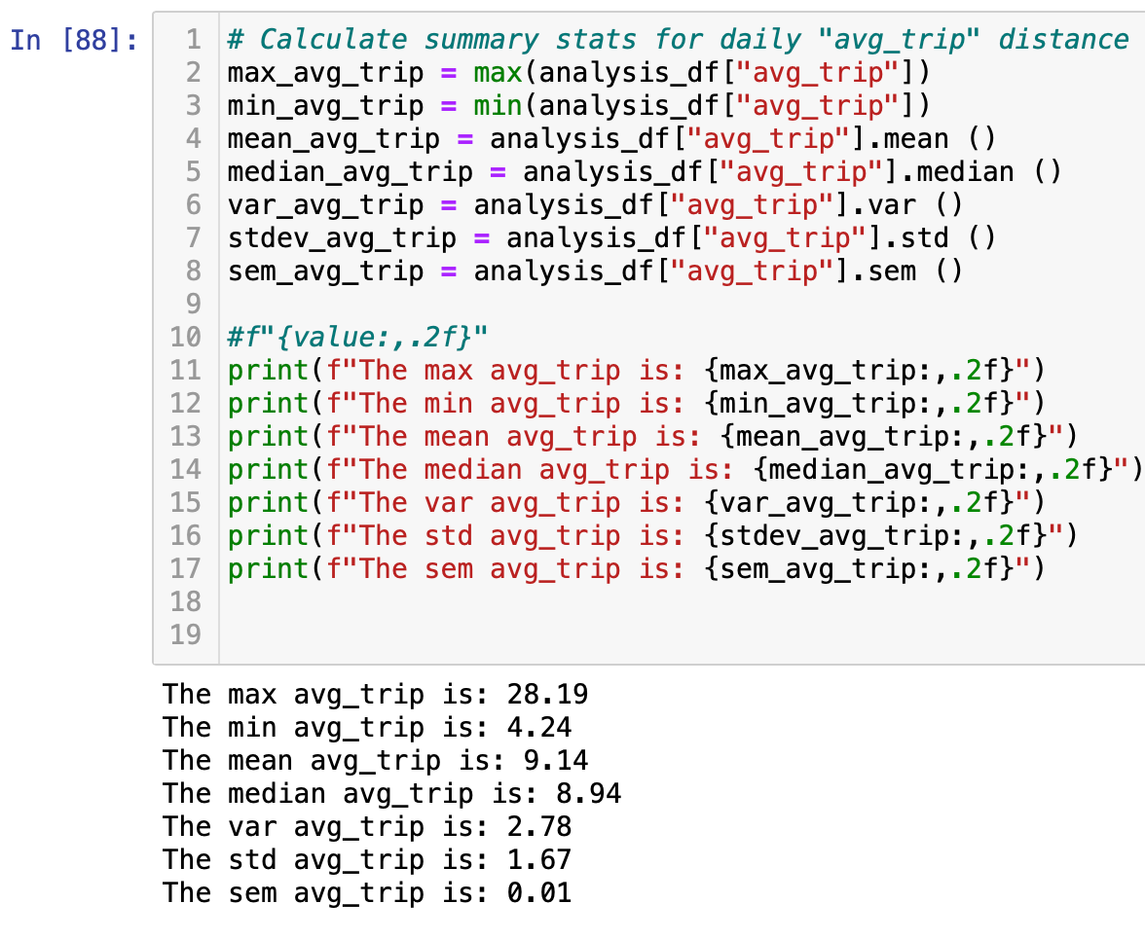
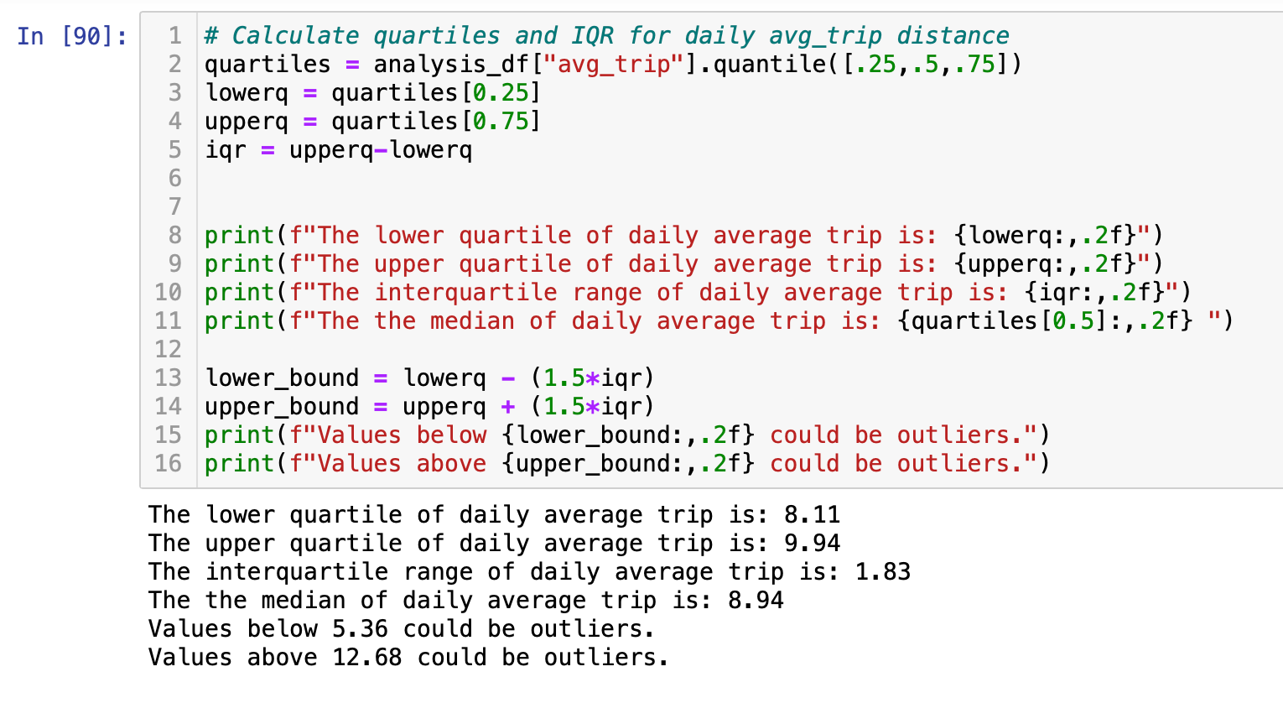
Comparison of Travel Distance by State
Erin
Calculated “avg trip” as total distance traveled divided by number of trips for each day.
Pulled Summary Statistics
Mean = 9.14
SEM = 0.01
Upper bound: 12.68; Lower bound: 5.36

Slide 7
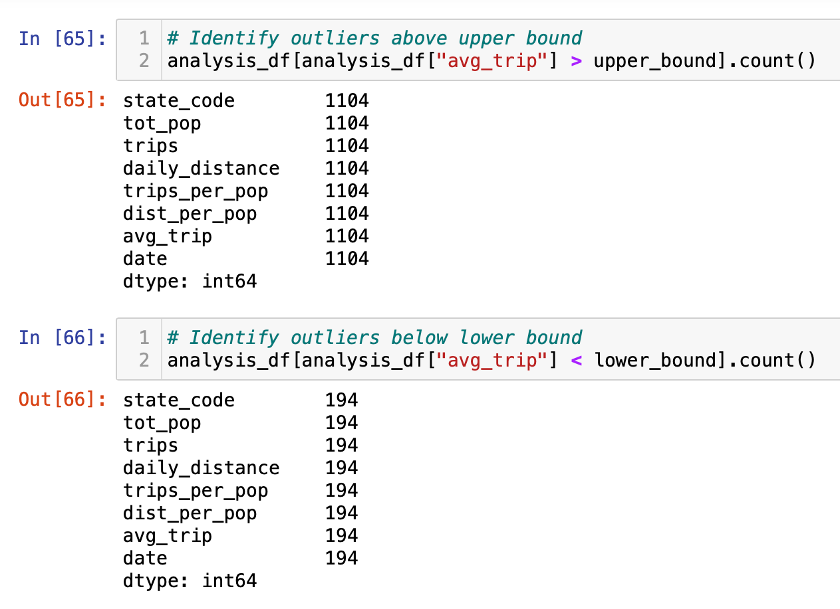
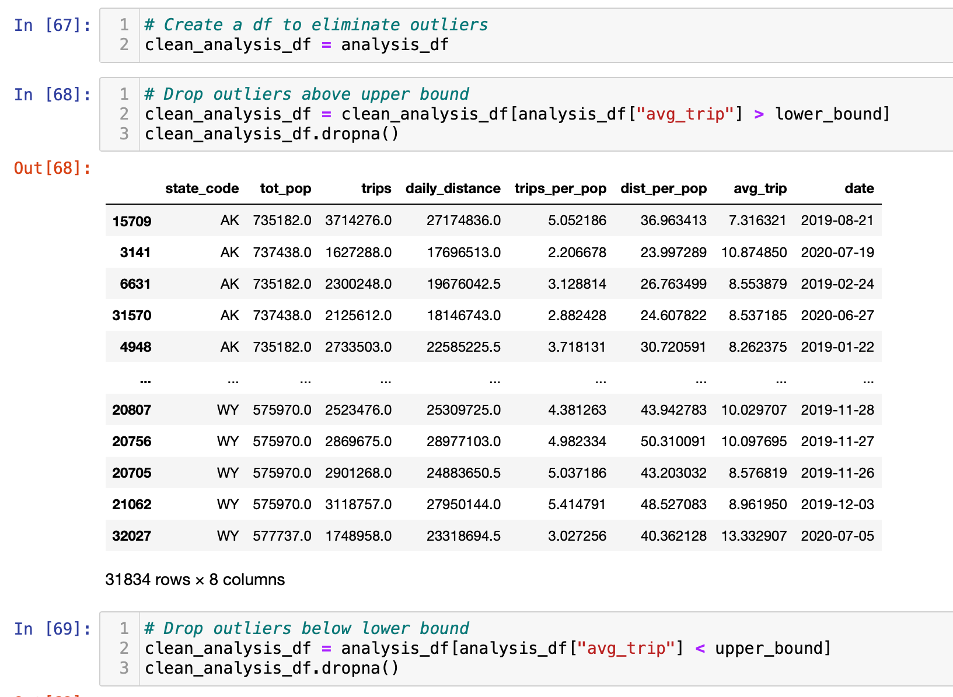
Comparison of Travel Distance by State
Identified count of outliers above upper band: 1,104
Identified count of outliers below lower band: 194
Removed outliers and created a clean dataframe

Slide 8
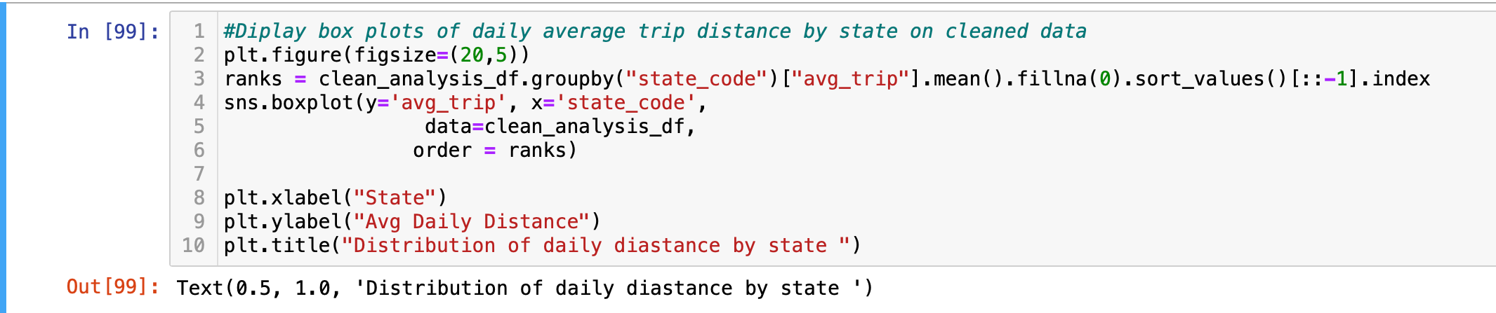
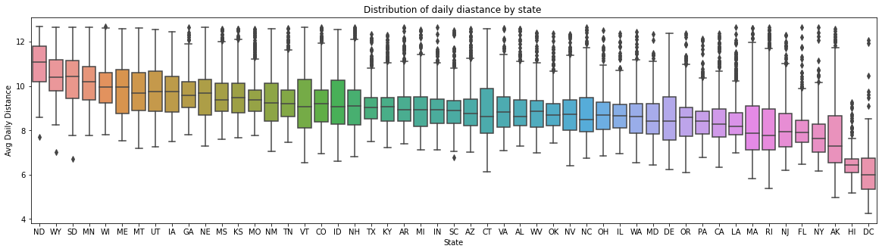
Comparison of Travel Distance by State
Displayed box plots of average daily trip distance grouped by state.
Longest 5 states: ND, WY, SD, MN WI Shortest 5 states: DC, HI, AK, NY, FL

Slide 9
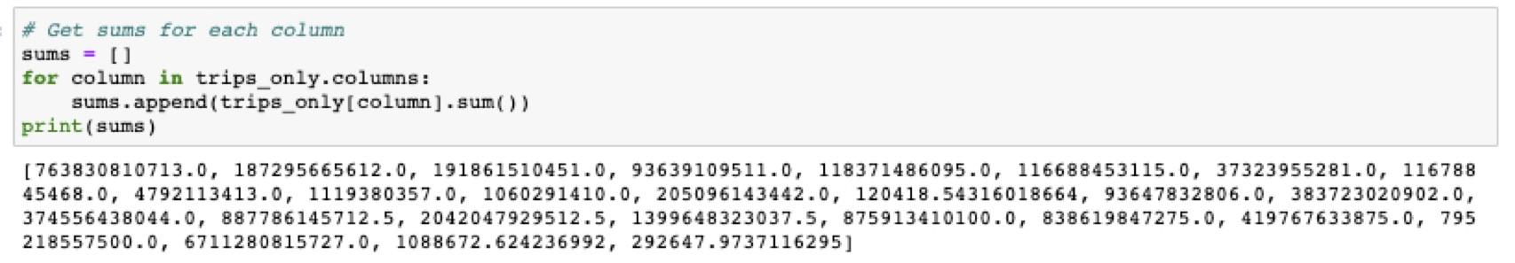
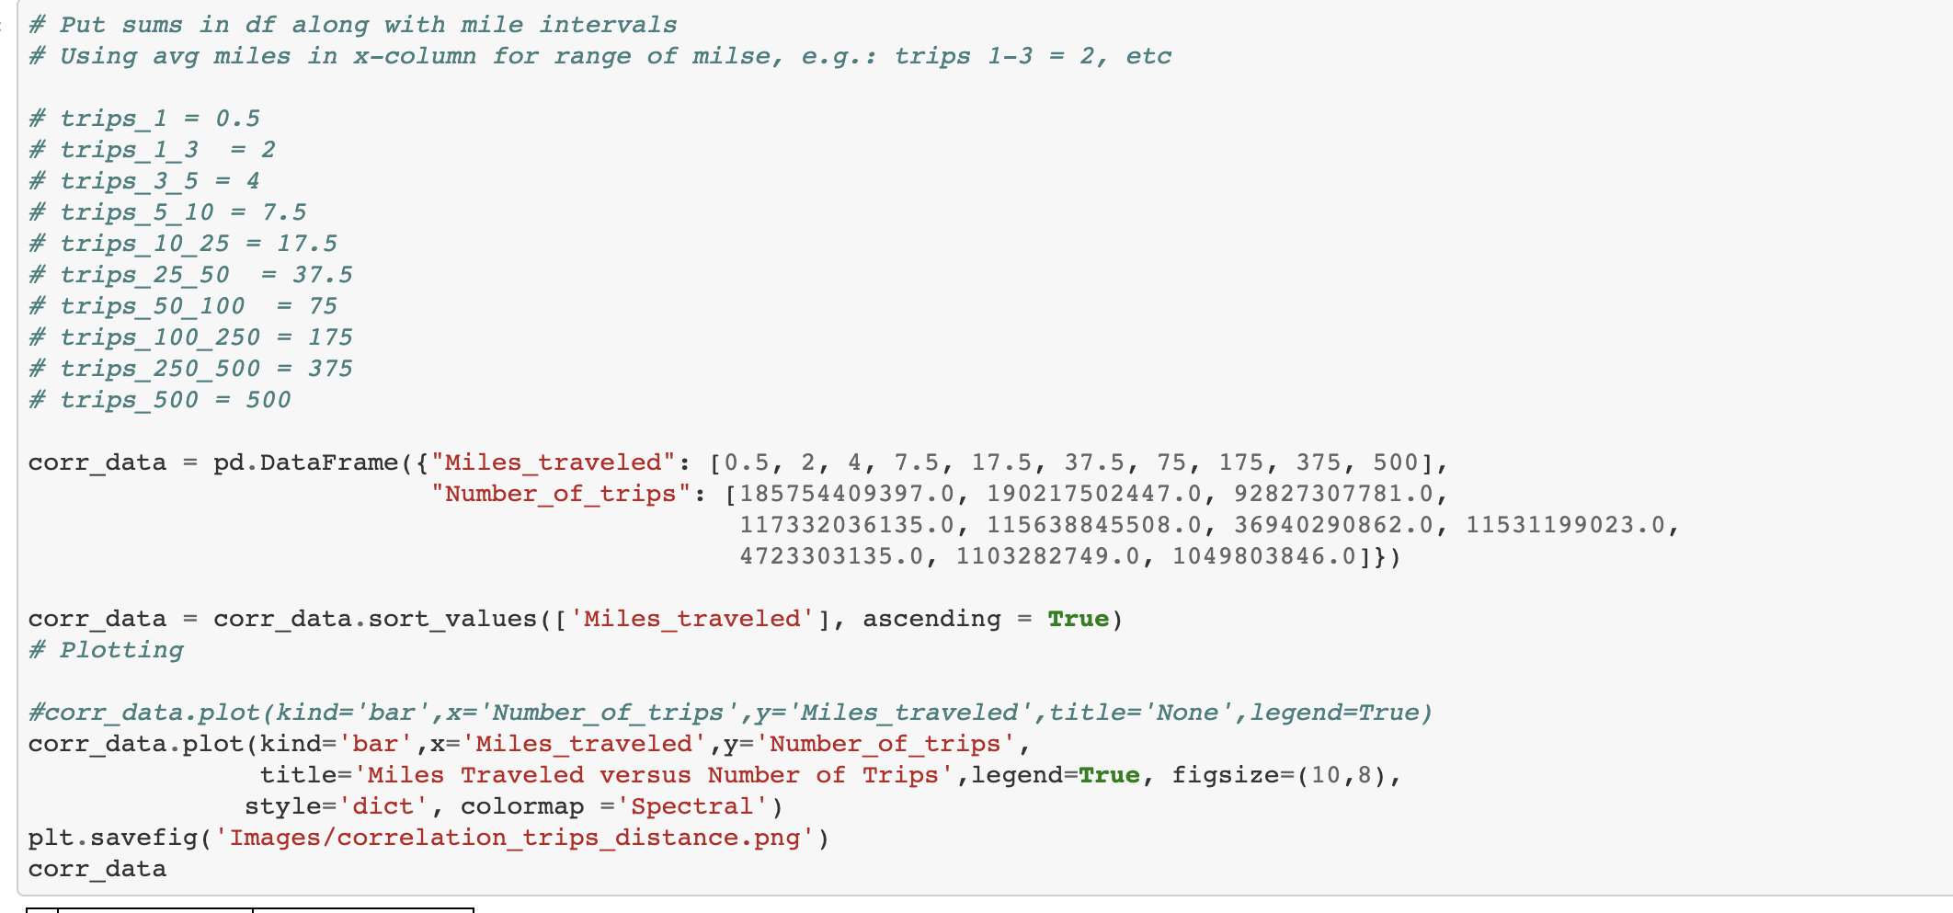
Data Analysis –Distance vs # of Trips
Rainer
Many people take trips daily - but how does distance affect the number of trips taken?

Slide 10
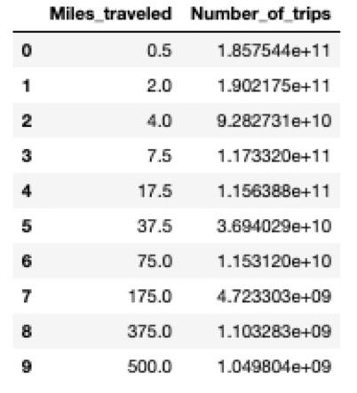
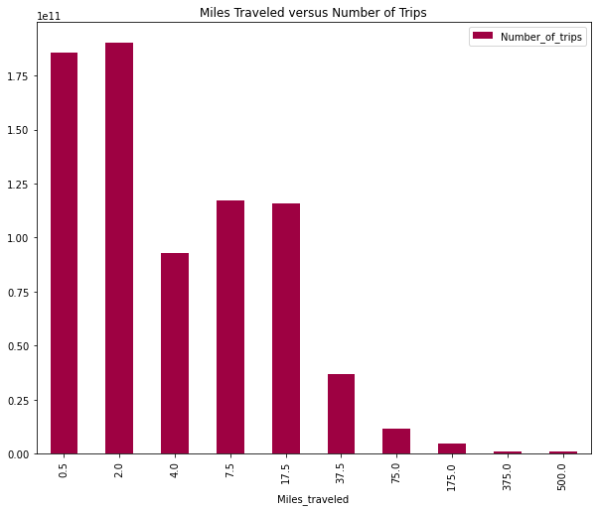
Data Analysis –Distance vs # of Trips

Slide 11
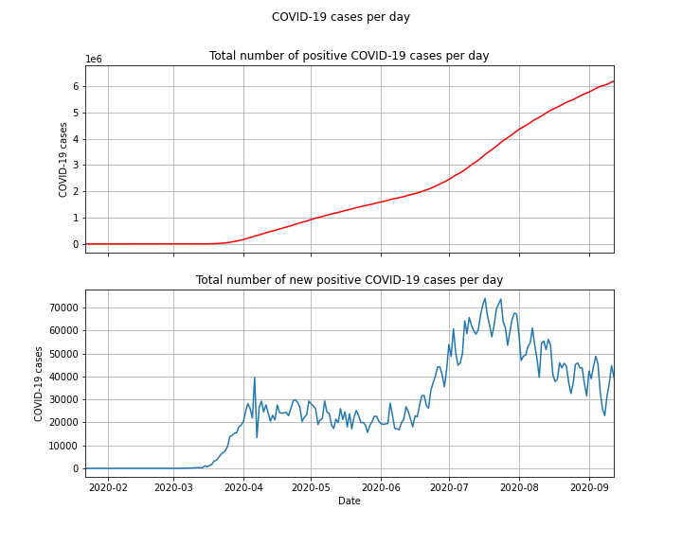
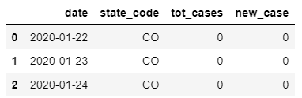
Travel data during COVID-19 analysis
Maria
Data source: Centers for Disease Control and Prevention (CDC) - US Department of Health and Human Services.
https://healthdata.gov/
Dataframe shape: (14880, 15) - CSV reading file
Cleaning:
Converted format to float for all numeric columns
Converted ‘date’ column to usable data by “apply(pd.to_datetime)”

Slide 12
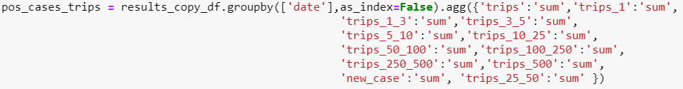
Travel data during COVID-19 analysis
Has the amount of trips decreased during the pandemic?

Slide 13
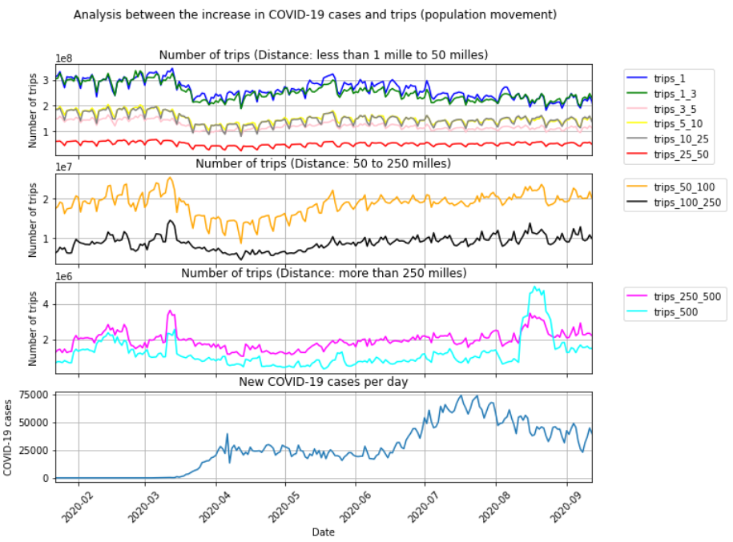
Travel data during COVID-19 analysis
Has the amount of trips decrease during the pandemic?

Slide 14
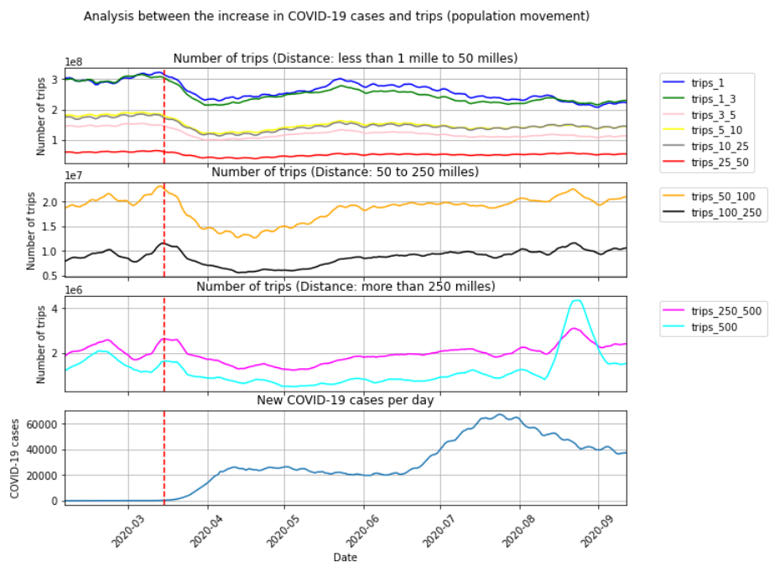
Travel data during COVID-19 analysis
Has the amount of trips decrease during the pandemic?

Slide 15
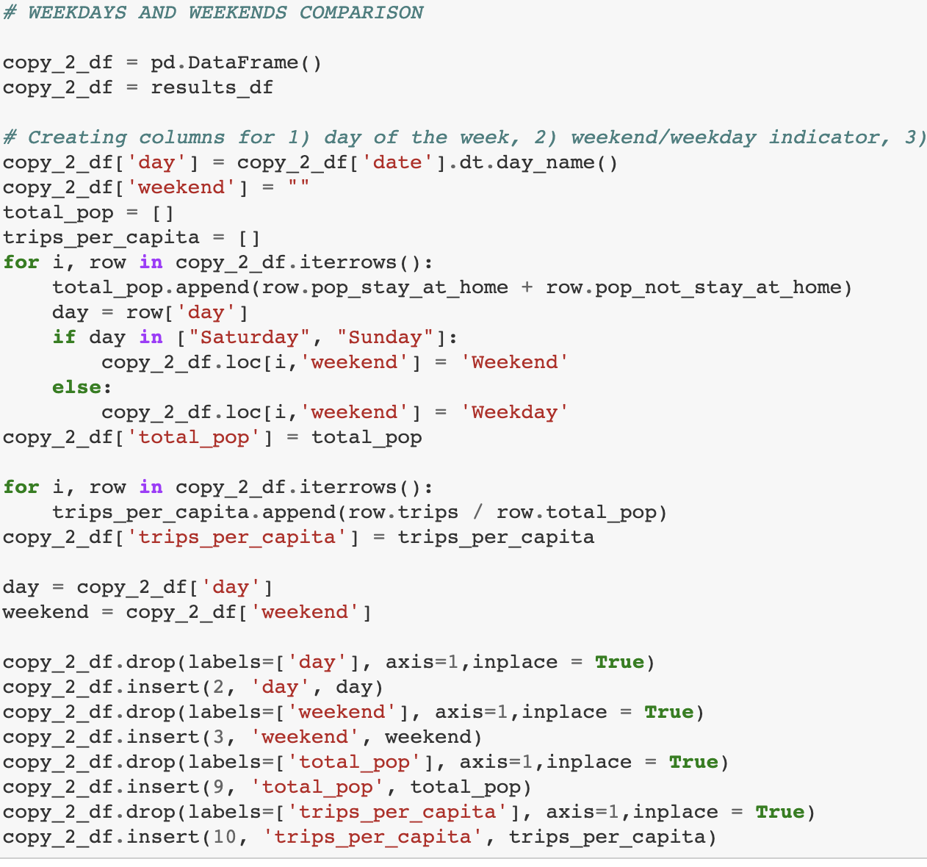
Weekend versus Weekday travel behavior
Mike
New Dataframe -
Identifying “day of the week” based on date
Labeling each entry “weekday” or “weekend”

Slide 16
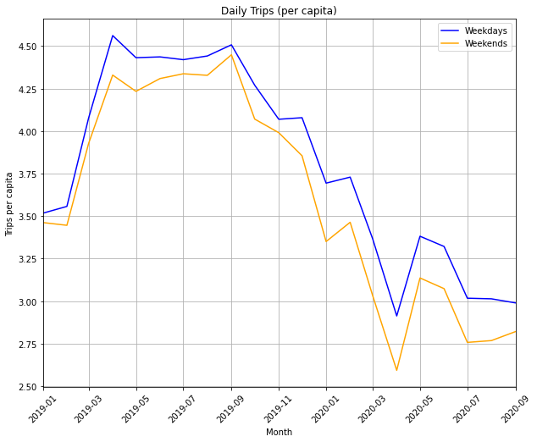
Weekend versus Weekday travel behavior
Key Findings:
Weekend trips are fewer than weekday trips
COVID caused a sharp drop-off in travel and slightly expanded the gap between weekend and weekday trips taken in Summer 2020 vs. Summer 2019

Slide 17
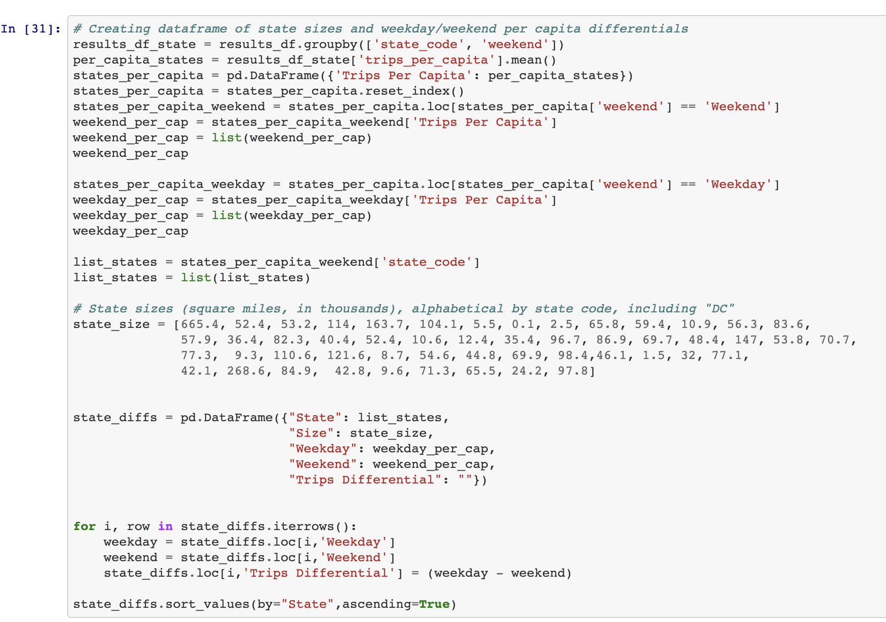
Weekend versus Weekday travel behavior
New Dataframe -
Identifying “day of the week” based on date
Labeling each entry “weekday” or “weekend”

Slide 18
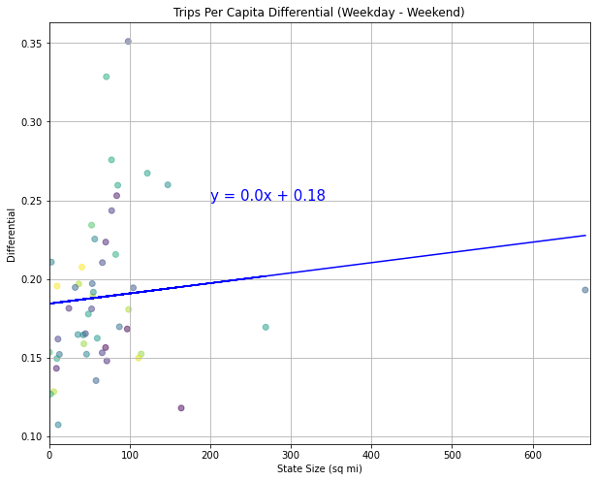
Weekend versus Weekday travel behavior by State Size
Question: Does state size have an impact on differential in weekend vs. weekday trip totals?
Finding: There is no significant correlation (r-squared: 0.015)

Slide 19
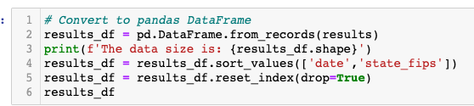
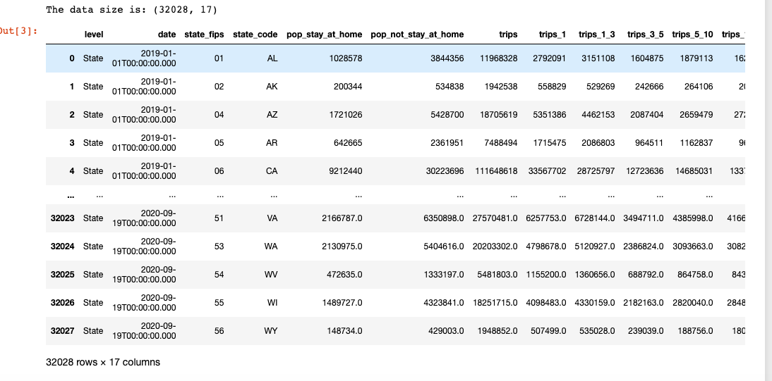
Comparison of NY State population that did not stay at home vs who did stay at home
Luis
Data Analysis -

Slide 20
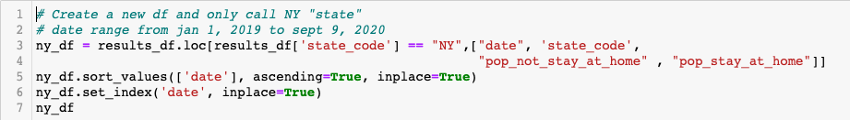
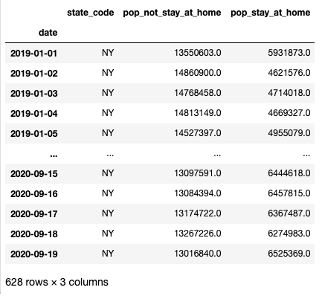
Comparison of NY State population that did not stay at home vs who did stay at home
Data Analysis -
New Dataframe - ny_df
Columns
Date
State code
Pop not stay at home
Pop stay at home

Slide 21
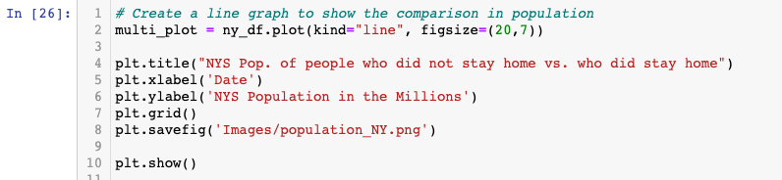
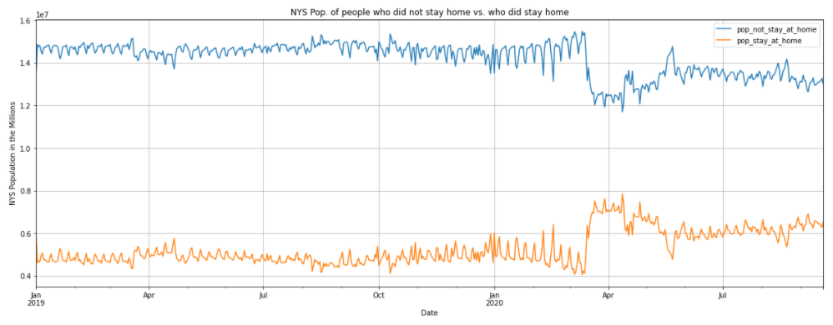
Comparison of NY State population that did not stay at home vs who did stay at home
Data Analysis - Line Graph showing the comparison of population movement
Blue line - pop. not stay at home
Orange line - pop. stay at home
X axis - Date
Y axis - NYS in the millions

Slide 22
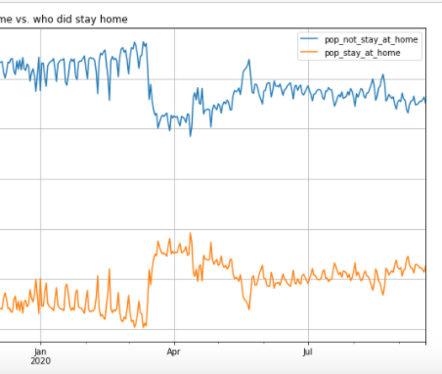
Comparison of NY State population that did not stay at home vs who did stay at home
Data Analysis - Conclusions
From data we can see that population movement was consistent from Jan 1, 2019 – March 2020.
There is a sharp decline in the population not staying at home which correlates with the sharp increase of people staying at home in March 2020 (COVID quarantine begins in NY).
The numbers then remain steady over the first month and then we see a peak in the population not staying home in late April-May and a second peak in late May/early June.
·

Slide 23


Comparison of NY State population that did not stay at home vs who did stay at home
Data Analysis - Conclusions
These peaks coincide with the Black Lives Matter protests and phase 1 NYS re-opening.
There has been a steady increase in the population not staying at home since June but the overall number of people that remains at home is steady. Likely due to work from home arrangements, flexible schedules, virtual schooling, social distancing regulations, etc.
·

Slide 24
Post Mortem
What difficulties did we face?
Lack of experience with github
Integrating our separate work within the repository
Time, time, time . . . .we could all use more time.
Additional questions or opportunities
We broke tasks up in the beginning and each worked on specific questions and collaborated to compile all our work in the end
Now seeing the individual analyses - we could further enhance our individual work based on the work of others.
Example: Incorporating the “state size” data into the travel distance by state analysis

Slide 25
Questions?

Slide 26
Appendix

Slide 27
Appendix – Skills Applied
Unit 6
API key for data retrieval
Dataframe created and saved as .csv
Unit 5
Summary statistics: mean, median, variance, standard deviation or SEM
Quartiles, IQR and Outliers
Plots created: scatterplot, line, bar, pie, box plot and saved as png
Linear regression and correlation
Unit 4
Data manipulation using:
Groupby
Merge dataframes
Drop duplicates
Identify unique

Slide 28
Appendix – Skills Applied
Python dependencies used:
import matplotlib.pyplot as plt
import requests
from scipy import stats
from scipy.stats import linregress
import pandas as pd
import numpy as np
import json
import datetime as dt
import seaborn as sns
import matplotlib.dates as mdates
# - Install sodapy (pip install sodapy)
# - In the config.py file write your username, password, and app_token
from sodapy import Socrata
from config import app_token
from config import username
from config import password

